Slide 1

WatchService Interface
The final type I want to talk about, is kind of fun, it's the WatchService.
This is a special type of service, which watches registered objects for changes and events.
For example, a file manager may use a watch service, to monitor a directory for changes, so that it can update its display of the list of files, when files are created or deleted.
COMPLETE JAVA MASTERCLASS
WatcherService (the File Watcher)

Slide 2
Using a Watch Service
A Watchable object is registered with the watch service.
When events occur on the registered object, they're queued on the watch service.
A consumer can retrieve and process the event information, using the poll or take methods on the queue.
COMPLETE JAVA MASTERCLASS
WatcherService (the File Watcher)

Slide 3
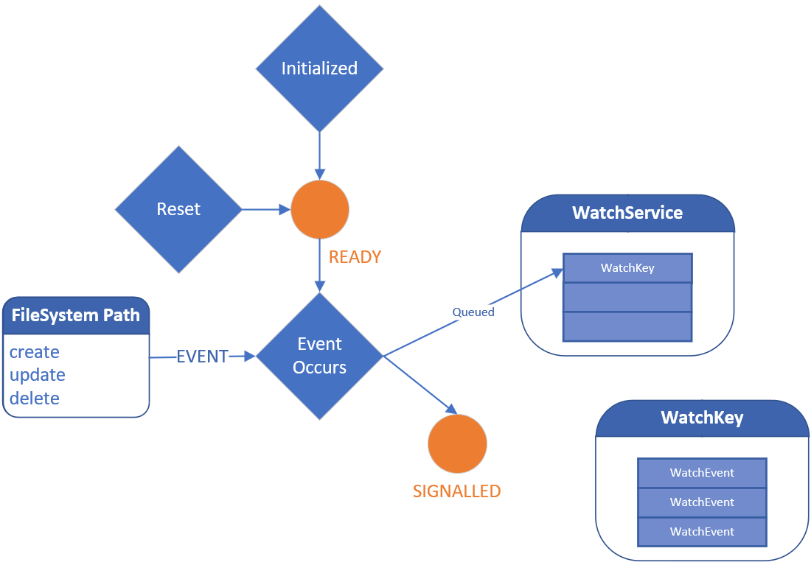
WatchKey States and Relationship
When initially created, the WatchKey is said to be ready.
When an event is detected, then the WatchKey is signalled, a special state, which means it can be polled.
A Watchkey gets queued at this point, on the WatchService, so that it can be retrieved, by invoking the watch service's poll or take methods.
Once signalled, a WatchKey remains in this state, until its reset method is invoked.
COMPLETE JAVA MASTERCLASS
WatcherService (the File Watcher)

Slide 4
WatchKey States and Relationship
When that happens, the WatchKey returns to the ready state.
Events detected while the key is in the signalled state, are added to the WatchKey.
A Watch Key has a list events, that occurred while the WatchKey was in the signalled state.
Each WatchEvent object represents a specific change, to the watchable object.
COMPLETE JAVA MASTERCLASS
WatcherService (the File Watcher)

